Slide 1
MATH-352 Numerical Methods
Atifa Kanwal
atifa.kanwal@seecs.edu.pk
Office # 303, Faculty Block, SEECS, NUST

Slide 2
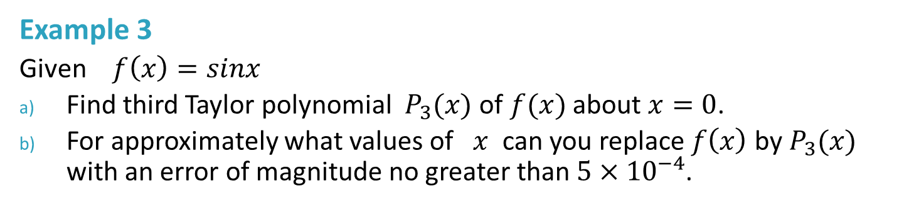
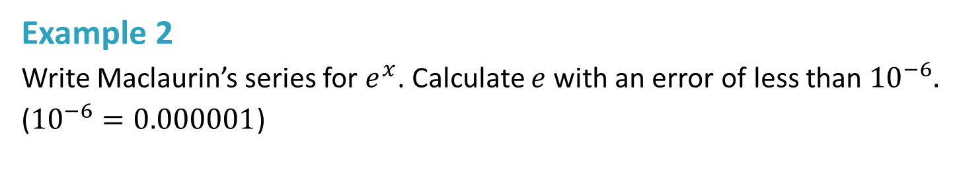
Taylor Series and Truncation error
Example 2
Write Maclaurin’s series for $e^{x}$. Calculate $e$ with an error of less than ${10}^{−6}.$
(${10}^{−6}=0.000001$)
Example 3
Given $f\left(x\right)=sinx$
Find third Taylor polynomial $P_{3}(x)$ of $f(x)$ about $x=0$.
For approximately what values of $x$ can you replace $f\left(x\right)$ by $P_{3}(x)$ with an error of magnitude no greater than $5×{10}^{−4}$.

Slide 3
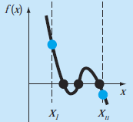
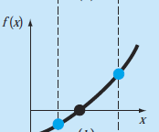
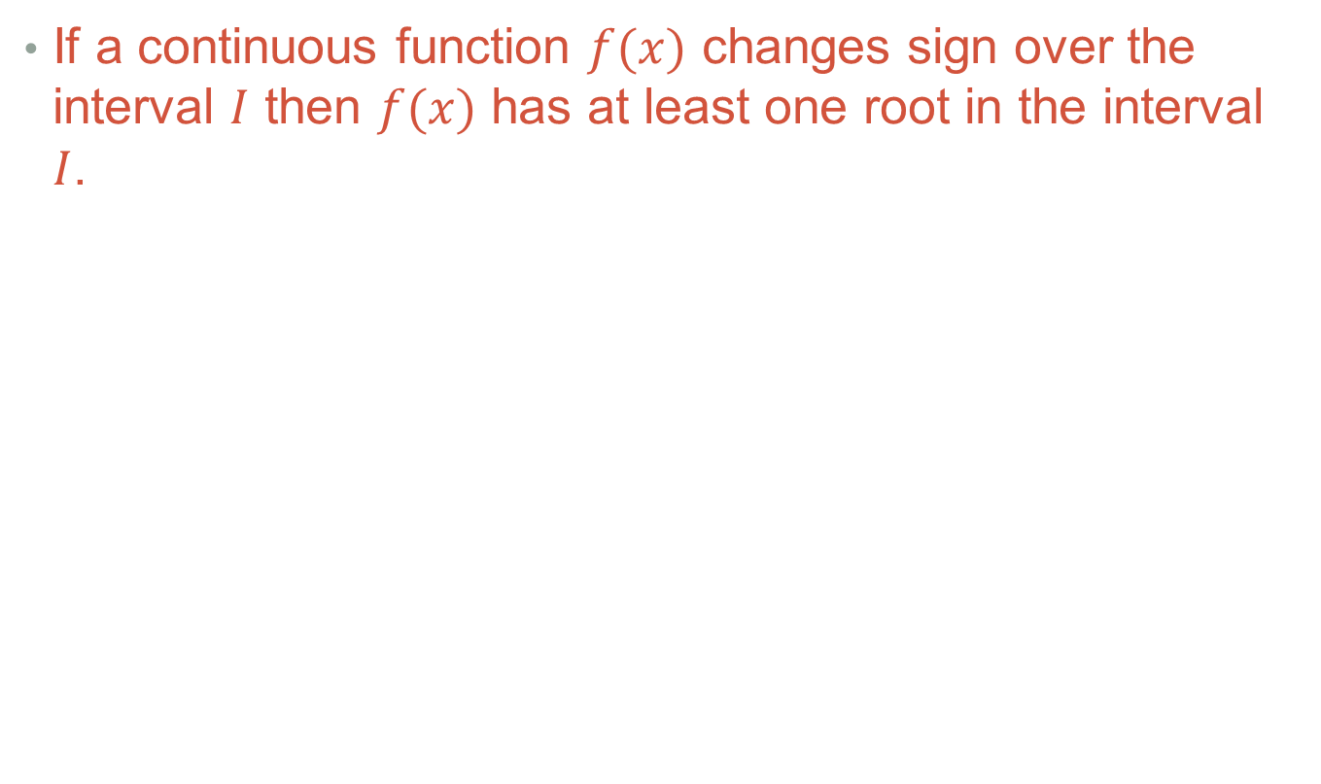
Root of a Nonlinear equation
If a continuous function $f(x)$ changes sign over the interval $I$ then $f(x)$ has at least one root in the interval $I$.

Slide 4
Methods to solve Nonlinear equation
Bracketing Methods
Open Methods
Secant Method
Bisection Method
False Position Method
Newton Raphson Method

Slide 5
Bracketing Methods
These techniques are called Bracketing methods because two initial guesses(first approximation) for the root are required. These guesses must bracket or be on either side of the root.
Methods described herein employ different strategies to systematically reduce the width of the bracket and hence home in on the correct answer.

Slide 6
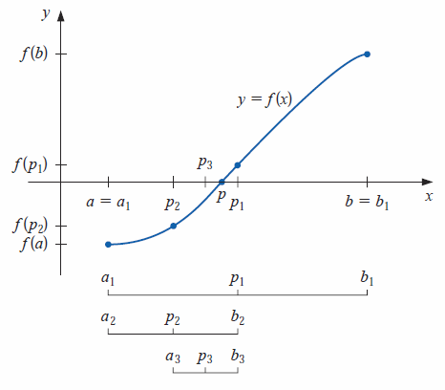
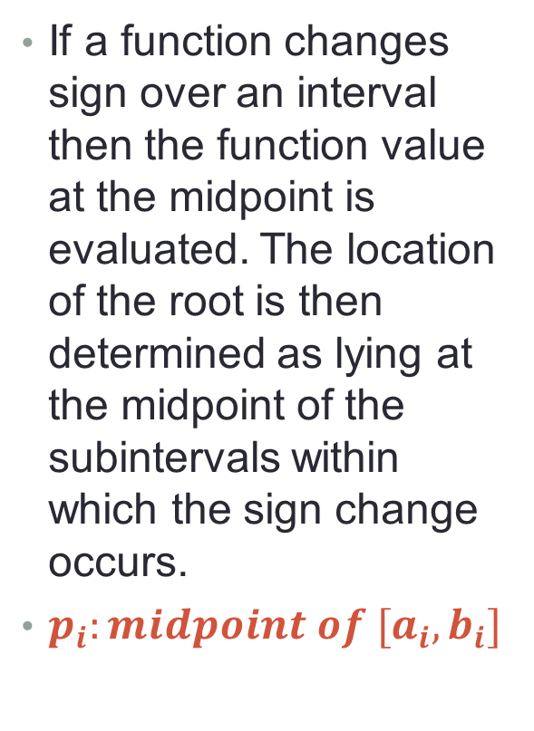
1. Bisection Method
If a function changes sign over an interval then the function value at the midpoint is evaluated. The location of the root is then determined as lying at the midpoint of the subintervals within which the sign change occurs.
$p_{i}:midpoint of [a_{i},b_{i}]$

Slide 7
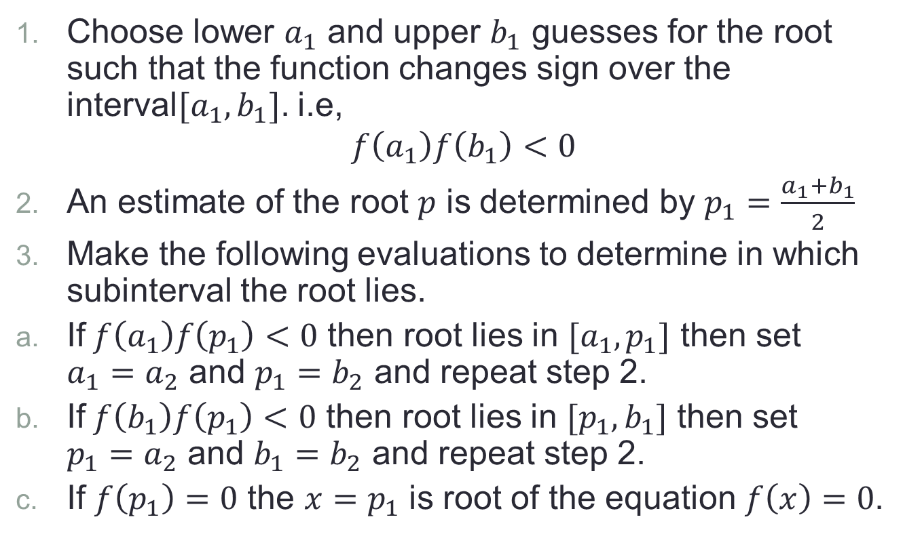
Algorithm
Choose lower $a_{1}$ and upper $b_{1}$ guesses for the root such that the function changes sign over the interval$[a_{1},b_{1}]$. i.e,
$$f\left(a_{1}\right)f\left(b_{1}\right)<0$$
An estimate of the root $p$ is determined by $p_{1}=\frac{a_{1}+b_{1}}{2}$
Make the following evaluations to determine in which subinterval the root lies.
If$f\left(a_{1}\right)f\left(p_{1}\right)<0$ then root lies in $[a_{1},p_{1}]$ then set $a_{1}=a_{2}$ and $p_{1}=b_{2}$ and repeat step 2.
If$f\left(b_{1}\right)f\left(p_{1}\right)<0$ then root lies in $[p_{1},b_{1}]$ then set $p_{1}=a_{2}$ and $b_{1}=b_{2}$ and repeat step 2.
If $f\left(p_{1}\right)=0$ the $x=p_{1}$ is root of the equation $f\left(x\right)=0$.

Slide 8
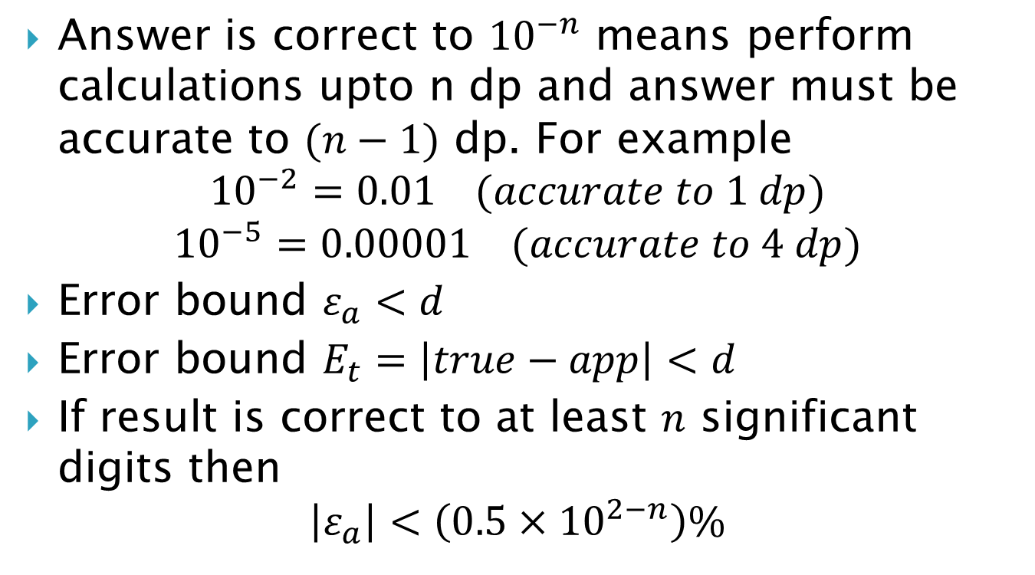
Stopping/Termination Criterion
Answer is correct to ${10}^{−n}$ means perform calculations upto n dp and answer must be accurate to $(n−1)$ dp. For example
$${10}^{−2}=0.01 (accurate to 1 dp)$$
$${10}^{−5}=0.00001 (accurate to 4 dp)$$
Error bound $ε_{a}<d$
Error bound $E_{t}=\left|true−app\right|<d$
If result is correct to at least $n$ significant digits then
$$\left|ε_{a}\right|<\left(0.5×{10}^{2−n}\right)\%$$

Slide 9
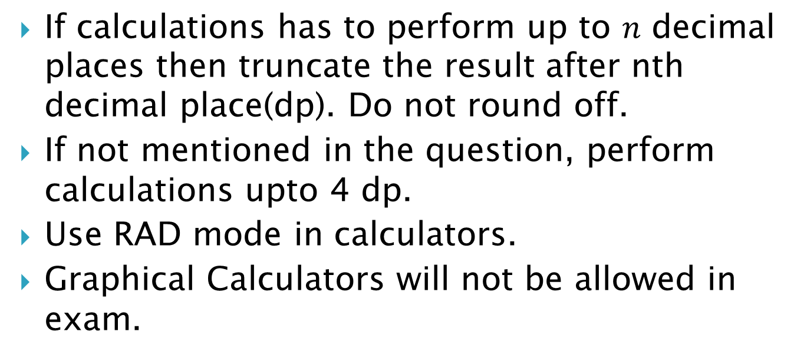
Instructions about Calculations in this course
If calculations has to perform up to $n$ decimal places then truncate the result after nth decimal place(dp). Do not round off.
If not mentioned in the question, perform calculations upto 4 dp.
Use RAD mode in calculators.
Graphical Calculators will not be allowed in exam.

